Slide 1
Chapter 12
Prosocial Behaviors

Slide 2
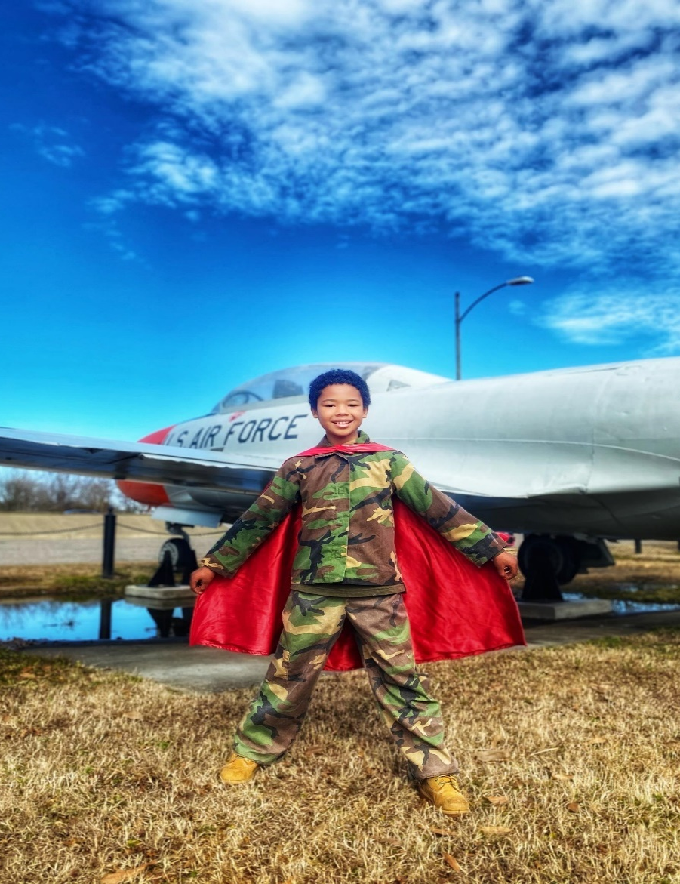
Tyler Stallings: created “Hero Bags” for homeless veterans

Slide 3

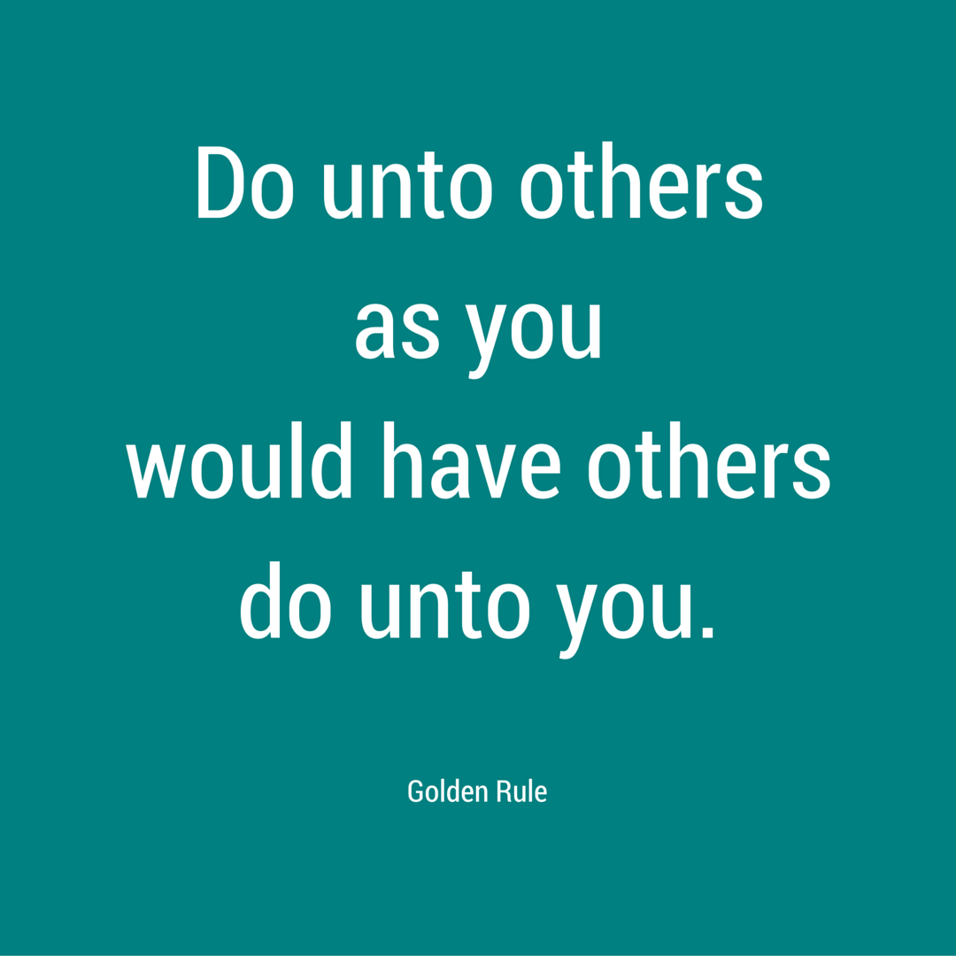
Why Does Prosocial Behavior Matter?
Engaging in prosocial behavior:
  More meaning and purpose in life
  More happiness and life satisfaction
  More popular in grades 3 – 8
  More attractive to others
  Social structure rely on prosocial behaviors
  It seems like the “right” thing to do

Slide 4
Altruism
Behavior by an animal (including humans) that is not beneficial to or may be harmful to itself but that benefits others of its species
Types of altruism, based on evolutionary theory:

Slide 5
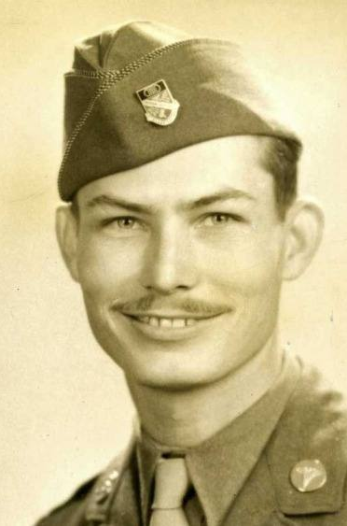
Desmond Doss
The only conscientious objector to receive the Medal of Honor. He saved 75 men.
This Photo by Unknown Author is licensed under CC BY-SA-NC

Slide 6

Hacksaw Ridge Desmond Doss

Slide 7

Hacksaw Ridge Desmond Doss

Slide 8
Psychological Motivations for Altruism
Egoism-Motivated Altruism
Engaging in prosocial behaviors because it benefits you to do so
Financial rewards, social capital, increased self-worth
Empathy-Motivated Altruism
Engaging in helping behaviors to reduce the needs of others, without consideration of costs or benefits to self
Altruism can be motivated by empathetic concern, an emotional response that occurs when we see others in need

Slide 9
More evidence that empathy predicts altruism
Healthcare workers more likely to sanitize hands when reminded it keeps patients safe than when reminded it keeps them safe (Grant & Hoffman, 2011)
Empathy for most vulnerable in population associated with social distancing in US, UK, and Germany at beginning of COVID-19 pandemic (Pfattheicher et al., 2020)
Inducing empathy resulted in higher motivation to adhere to social distancing (saw video of man who couldn’t be with wife)
Altruistic kidney donors more activation in bilateral anterior insula (empathy area)than controls when watching others experience pain (Brethel-Haurwitz et al., 2018)

Slide 10
Benefits of Giving Support
Toddlers aged 19 to 23 months, coded as happier when giving treats than when receiving them (d = 1.12)
Also, happier when giving away own treats to a puppet compared to giving away experimenter’s treats (d = .46) Aknin et al., 2012
Older adults (N = 1,118) who reported giving more help also reported being physically healthier
To relatives or non-relatives
Controlling for: age, gender, ethnicity, education, income, marital status, size of social network, functional mobility
Neither receiving help nor reciprocity related to health
Brown et al., 2005

Slide 11
Even More Benefits of Giving Support!
Older married adults (N = 846)
Prosocial behavior = unpaid hours providing instrumental support to people with whom they don’t live
Stress related to increased risk of death in next 5yrs
Prosocial behavior related to decreased risk of death
Prosocial behavior moderated association between stress and death Poulin et al., 2013
Providing support related to psychological benefits even for those with recent trauma (Frazier et al., 2013) and after recent loss of spouse (Brown et al., 2008)

Slide 12
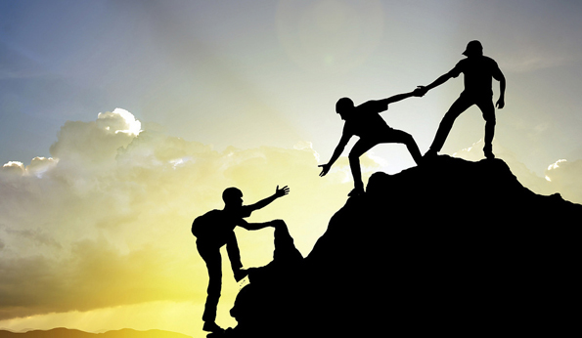
Journal Entry #21
What are 3 kind things you could do today to help out another person?

Slide 13
Who is Most Likely to Provide Support?
Women more than men
Older people more than younger people
People who identify as religious more than those who don’t
High on Agreeableness and Honesty Humility
Machiavellianism , psychopathy, and Narcissism associated with less prosocial behavior

Slide 14
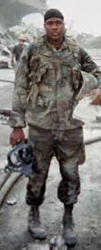
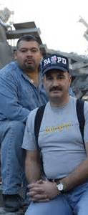

Altruism
Jason Thomas
  Was in Long Island
  Had been out of Marines
  Put on fatigues and drove to NYC
Dave Karnes
  Accountant; was in Wilton CT; left work
  23yr Marine veteran
  Drove to church and asked them to pray that God would lead him to survivors
  Reinlisted
Will Jimeno and John Mcloughlin

Slide 15


Slide 16
When are People Most Likely to Be Prosocial?
In a sample of males, participants more cooperative after completing stressful task von Dawans et al., 2012
More likely to be prosocial when experiencing positive emotions Aknin et al., 2018
Subjective well-being in community is associated with “extraordinary” altruism
Statewide rates of altruistic kidney donation correlated with statewide rates of subjective well-being
Brethel-Haurwitz & March, 2013

Slide 17


Slide 18

https://www.santiagohs.org/apps/video/watch.jsp?v=24055

Slide 19
Why Are Prosocial Behaviors Good for Us?
In an undergrad sample, giving support associated with lower blood pressure Piferi & Lawler, 2006
Participants assigned to engage in prosocial behavior to specific people across four weeks had decreases in the expression of CTRA (conserved transcriptional response to adversity) indicator genes (CTRA is a pattern of gene expression changes in immune cells that occurs in response to chronic stress, adversity, or threat) Nelson-Coffey et al., 2017
  No changes for those assigned to prosocial behavior toward the world, self-kindness, or neutral conditions
  Why prosocial related to better health: engage in prosocial may lower levels of CTRA pattern

Slide 20
Kindness Interventions
Meta-analytic evidence suggests kindness interventions are linked to improved well-being for the helper
Small to medium sized increases in well-being
Strength of effect not impacted by sex, age, type of intervention, control conditions, or outcome measure
Effects attenuated by:
Engaging in prosocial behaviors for self-oriented reasons
Feeling obligated to engage in prosocial behaviors

Slide 21
Alden & Trew (2013)
Undergraduate students with elevated social anxiety in 4-week intervention
Randomized to:
  Acts of Kindness (AK) 3x/day for 2 days/week
  Behavioral Experiments (BE) 2 days/week
  Life Details (LD) – record 3 events/day for 2 days/week
Participants in AK greater increases in PA and relationship satisfaction and decreases in efforts to avoid negative social consequences than BE & LD
No group differences in NA or social approach behaviors

Slide 22
Compassionate Goals
Self-image goals: focus on constructing and maintaining images of the self
Compassionate goals: focus on supporting others and ensuring that you aren’t causing harm
  What is good for others is also good for you
  More satisfying relationships
  Tend to be held in higher esteem by others
  Related to decreases in symptoms of depression and anxiety over 10-weeks in college students (Crocker et al., 2010)
  In those diagnosed with depression or anxiety disorders, associated with fewer daily symptoms and perceptions of support from others over 10 days (Erickson et al., 2017)

Slide 23

Moral Elevation
Warm uplifting feeling that you get when you see unexpected acts of human goodness, kindness, courage, or compassion
Provides evidence of morality, human decency, pride, community, etc.
Opposite of social disgust
Described as being touched, inspired, or moved
Promotes prosocial motivation
Related to psychological growth and compassionate goals following trauma (Tingey et al., 2019)

Slide 24
Singularity Effect of Identifiable Victims
Tendency to have stronger reactions to and more willingness to help an identified individual as opposed to a group with the same need
People tend to be relatively insensitive to the scale or scope of need/crisis
Participants with collectivistic values less likely to demonstrate this effect
  More likely to contribute to group than those with less collectivistic values
  When primed with collectivistic values – using we, us, ours – more likely to donate to group than individual
  Kogut et al., 2015

